Slide 1


ArogyaRakshak
AI-Assisted Healthcare Decision Support Platform
A unified platform that streamlines the post-discharge administrative healthcare journey — auditing bills, benchmarking medicine prices, estimating government scheme eligibility, and preparing insurance claims through a shared AI orchestration engine.
Project Guide: Prof. [Guide Name] · Department: Computer Engineering · Academic Year: 2026-27 · Team: Viraj Jadhao, Anurag Pawar, Sanjali Paygude, Raj Janvekar, Arya Chandak

Slide 2
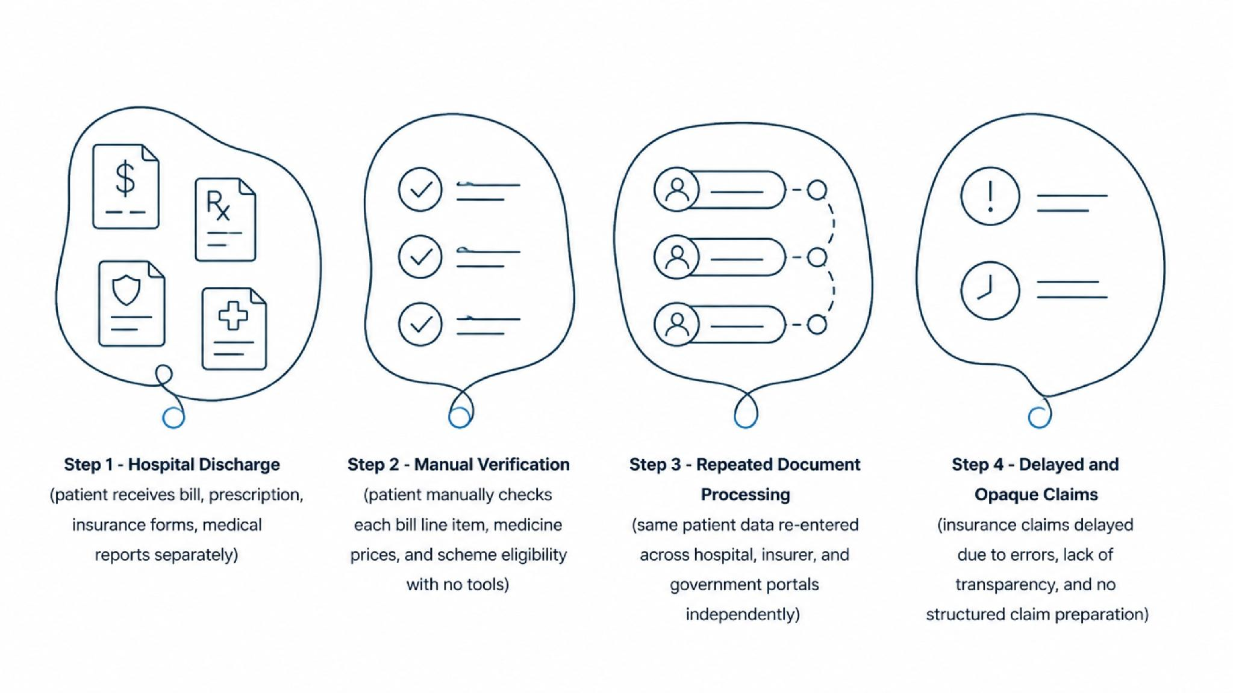

The Post-Discharge Paperwork Crisis
After discharge, a patient receives a hospital bill, prescription, insurance forms, and medical reports — each requiring manual verification, repeated processing, and opaque pricing. There is no unified intelligent workflow.
Manual Verification
Repeated Processing
No automated cross-checking of bill line items against standard rates
Same patient data re-entered across hospital, insurer, and government portals
Lack of Transparency
Delayed Claims
Patients cannot verify fair pricing or scheme eligibility independently
Errors and incomplete documentation cause insurance claim rejections
Core Problem: There is no unified intelligent workflow connecting discharge documents to actionable, structured outputs.

Slide 3
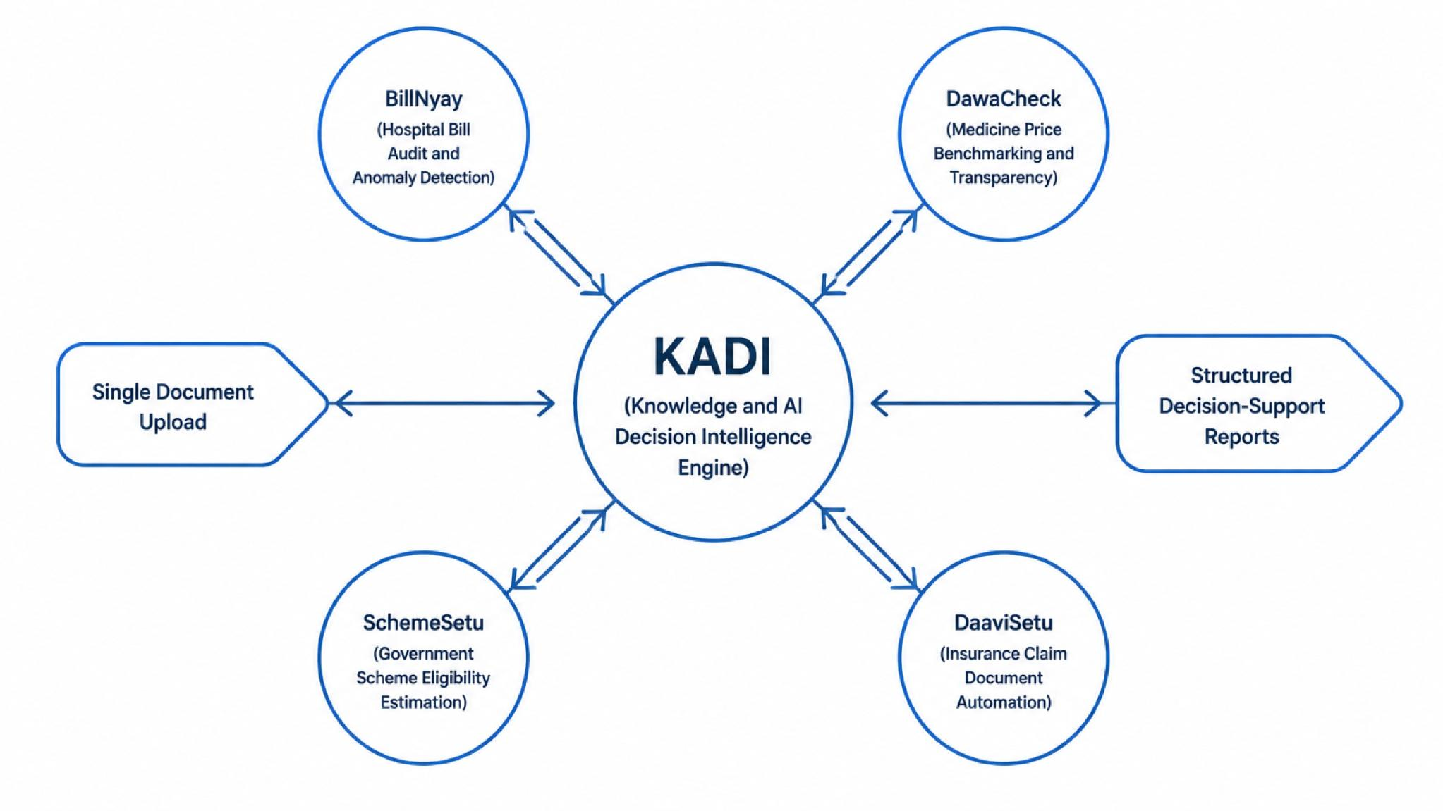




ArogyaRakshak: One Platform, Four Intelligent Modules
ArogyaRakshak replaces fragmented manual workflows with a single intelligent platform. The patient uploads documents once — KADI (Knowledge & AI Decision Intelligence) orchestrates context across all four modules and generates structured decision-support outputs.
BillNyay
DawaCheck
Hospital Bill Audit
Medicine Price Intelligence
SchemeSetu
DaaviSetu
Government Scheme Eligibility
Claim Document Automation

Slide 4
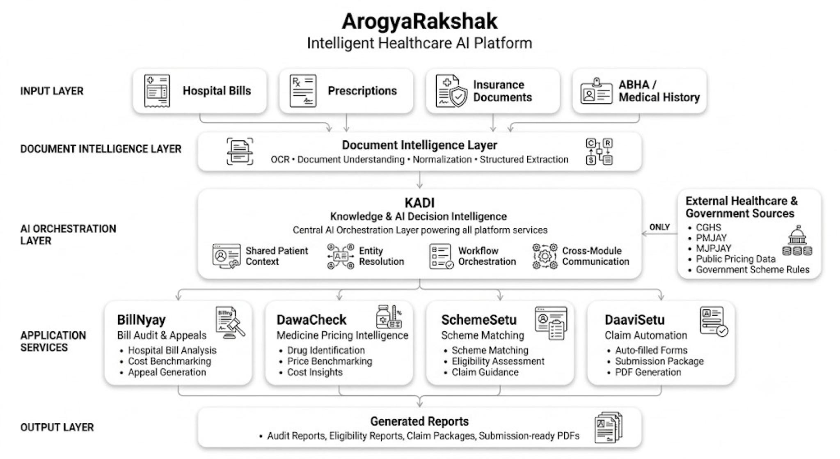
System Architecture
A layered architecture separates concerns across document ingestion, AI processing, orchestration, and output generation. Each layer is independently deployable and testable.

Slide 5
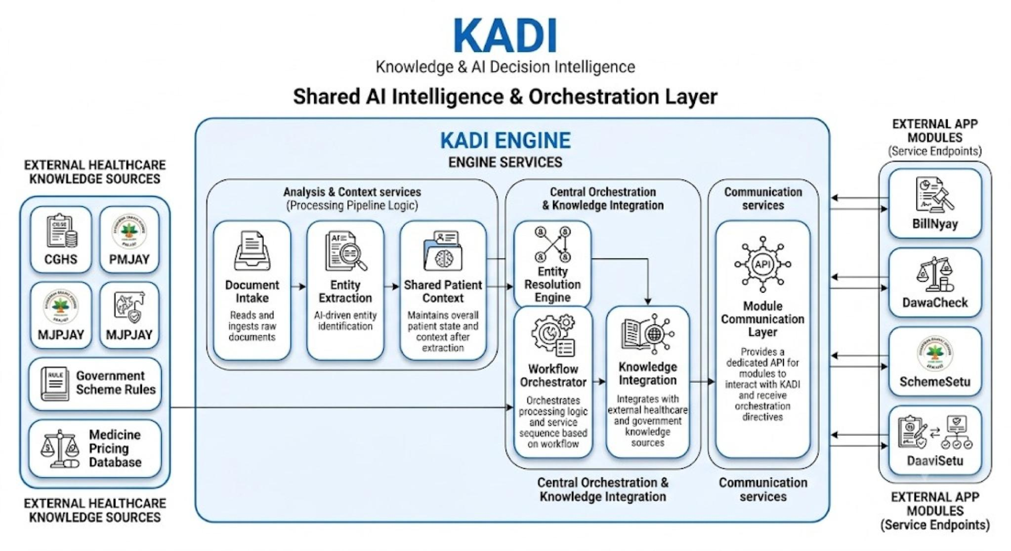
KADI: Knowledge & AI Decision Intelligence
KADI is the architectural differentiator. Without it, each module operates in isolation — performing independent OCR, maintaining separate state, and producing uncoordinated outputs. KADI replaces this with a single shared context that all modules consume and enrich.
Before KADI
After KADI
Each module performs OCR independently
No shared patient context across modules
Redundant extraction and processing
Inconsistent entity resolution
No cross-module intelligence
Single OCR pass — results shared across all modules
Unified patient context as single source of truth
Shared intelligence layer for cross-module reasoning
Consistent entity resolution and normalization
Modules communicate through KADI, not directly

Slide 6
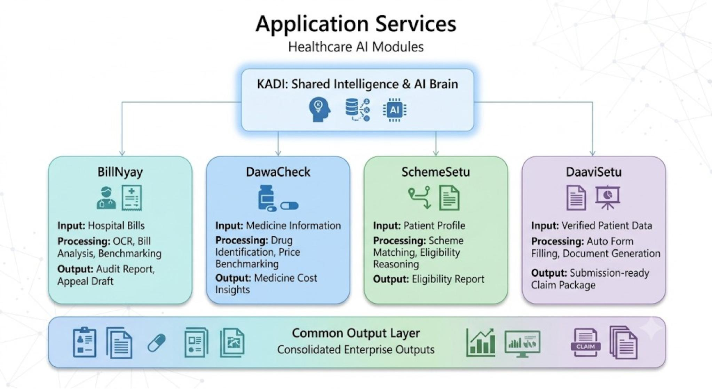
Four Application Modules
Each module is an independent service consuming shared context from KADI. Together, they cover the complete post-discharge administrative workflow — from bill verification to claim submission readiness.

Slide 7
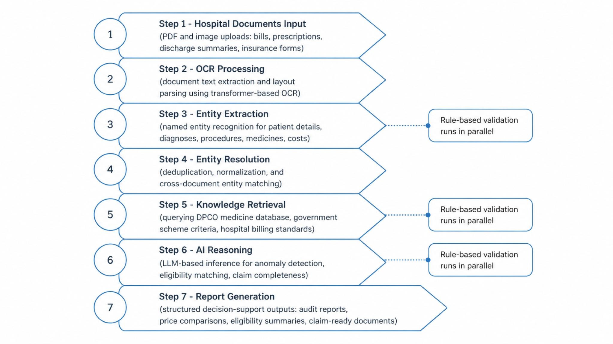
AI Processing Pipeline
The pipeline is a deliberate hybrid of AI and rule-based logic. AI handles unstructured extraction, semantic reasoning, and knowledge retrieval. Rule-based validation enforces deterministic checks on billing codes, scheme criteria, and form completeness — ensuring auditability and reproducibility.
Where AI Is Used
OCR on unstructured documents, entity extraction from clinical text, LLM-based reasoning for anomaly detection and eligibility matching, knowledge retrieval augmentation
Where Rules Are Used
ICD-10 and procedure code validation, DPCO price threshold checks, government scheme eligibility criteria matching, insurance form field completeness validation

Slide 8






Technology Stack
Each technology was selected for a specific architectural reason — not popularity. The stack prioritizes type safety, async performance, containerized deployment, and production-grade AI inference.
Frontend
Backend
React + TypeScript — component-driven UI with strict type safety. Tailwind CSS for utility-first responsive design. Chosen for ecosystem maturity and developer ergonomics.
Node.js + Express — async, non-blocking I/O ideal for document processing pipelines. TypeScript ensures end-to-end type consistency between frontend and backend.
Database
AI / ML
PostgreSQL — relational integrity for structured patient and claim data. Chosen for ACID compliance, JSON column support, and mature ORM ecosystem.
Transformer-based OCR (PaddleOCR / Tesseract), LLM for reasoning (open-source or API-based), spaCy for NER. Rule engine for deterministic validation logic.
Deployment
Containerization
Docker for containerization — ensures environment parity across development, testing, and production. Kubernetes-ready for horizontal scaling of AI inference services.
Docker Compose for local development orchestration. Each service (API, AI worker, database) runs in an isolated container with defined resource limits and health checks.

Slide 9
Implementation Status, Limitations & Future Roadmap
Honest assessment of current scope, acknowledged constraints, and a technically grounded roadmap for production readiness.
✅ Implemented
⚠️ Current Limitations
End-to-end document upload and OCR pipeline
KADI shared context orchestration engine
BillNyay bill audit with anomaly detection
DawaCheck medicine price benchmarking
SchemeSetu eligibility estimation engine
DaaviSetu claim form pre-population
Structured PDF report generation for all modules
Decision support only — no automatic approvals or binding recommendations
No live hospital EMR or insurance API integrations
OCR accuracy degrades on low-quality scanned documents
Government scheme criteria manually maintained — not live-fed
No multi-language prescription support beyond English
🔭 Future Roadmap
FHIR-compliant APIs for hospital EMR integration
ABDM (Ayushman Bharat Digital Mission) interoperability
Live hospital and insurer API partnerships
Knowledge Graph for scheme and procedure ontologies
Multi-language OCR for regional prescriptions

Slide 10
Impact & Conclusion
ArogyaRakshak demonstrates that shared AI intelligence — not isolated modules — is the correct architectural pattern for healthcare administrative workflows. The platform delivers measurable value across all stakeholders.
4
1
0
Integrated Modules
Unified Upload
Diagnosis Claims
Bill audit, medicine pricing, scheme eligibility, and claim automation in one workflow
Single document submission generates multiple intelligent structured outputs
Platform explicitly does not diagnose, treat, or approve — decision support only
Patients
Hospitals
Transparent bills, verified medicine prices, and claim-ready documentation without manual effort
Reduced administrative queries and standardized discharge documentation workflows
Government
Insurers
Improved scheme uptake through automated eligibility matching and reduced exclusion errors
Higher-quality, complete claim submissions reducing processing time and rejection rates
"A unified AI-assisted healthcare workflow powered by shared intelligence."
Thank you for your time and attention. We welcome technical questions on architecture, AI pipeline design, and healthcare interoperability standards.

